Slide 1
TITLE PAGE
Problem Statement ID – Question 5A
Problem StatementTitle-Grade Change Intiligence in Paper Making Process
Theme- Industry 4.0 – AI for Smart Manufacturing
PS Category- Software
Student Name – Atharv Vijaykumar Patil
Student ID – 23BSA10028
Site Live URL- https://honeywellgradechangeintligence-stejkkck6udc6tkmh9v8tq.streamlit.app/
GitHubrepo: https://github.com/AtharvCodeCraft/HoneywellGradeChangeIntligence
ZipFile : https://drive.google.com/file/d/1Pqk7IARvT0Fv9ClXjWlUfx5YqhdepoZX/view?usp=sharing

Slide 2
Grade Change Intelligence: AI-Powered Decision Support for Paper Manufacturing
Proposed Solution:
Detailed explanation of the proposed solution:
AI-powered system predicts paper grade-change risk using XGBoost.
SHAP Explainable AI identifies the key process parameters influencing predictions.
Smart dashboard provides recommendations, optimal setpoints, and downloadable PDF reports.
How it Addresses the Problem:
Detects potential quality issues early to reduce production losses and downtime.
Assists operators with data-driven recommendations for faster decision-making.
Improves product quality and process efficiency through continuous monitoring.
Innovation & Uniqueness:
Combines Machine Learning with Explainable AI for transparent predictions.
Integrates AI recommendations, correlation analysis, and optimal setpoint suggestions.
Enables operator feedback and automated PDF reporting in a single industrial dashboard.

Slide 3
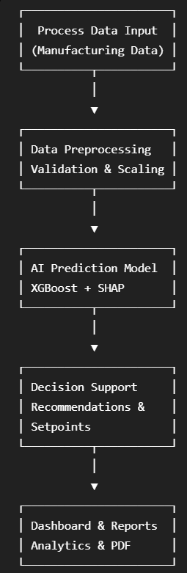
TECHNICAL APPROACH
Methodology and process for implementation:
Technical Approach:
Development and Visualization: Python, Streamlit, Pandas, NumPy, Matplotlib
Machine Learning: XGBoost, SHAP, Scikit-learn, Joblib
Report Generation : ReportLab & GitHub
Working Prototype:
Interactive Streamlit dashboard with real-time process analysis.
AI-generated recommendations, correlation heatmap, and confidence analysis.
PDF report generation with operator feedback support.

Slide 4
FEASIBILITY AND VIABILITY
Analysis of the Feasibility of the Idea
Uses proven technologies (Python, XGBoost, SHAP, Streamlit) that are reliable and industry-ready.
Easily integrates with existing manufacturing data and process monitoring systems.
Scalable solution that can be extended to multiple production lines and plants.
Potential Challenges and Risks
Model accuracy depends on the quality and availability of production data.
Process variations may require periodic model retraining and validation.
Integration with legacy industrial systems can be technically challenging.
Strategies for Overcoming These Challenges
Continuously retrain the model using new production and operator feedback data.
Implement data validation and preprocessing to improve prediction reliability.
Design a modular architecture for seamless integration and future scalability.

Slide 5
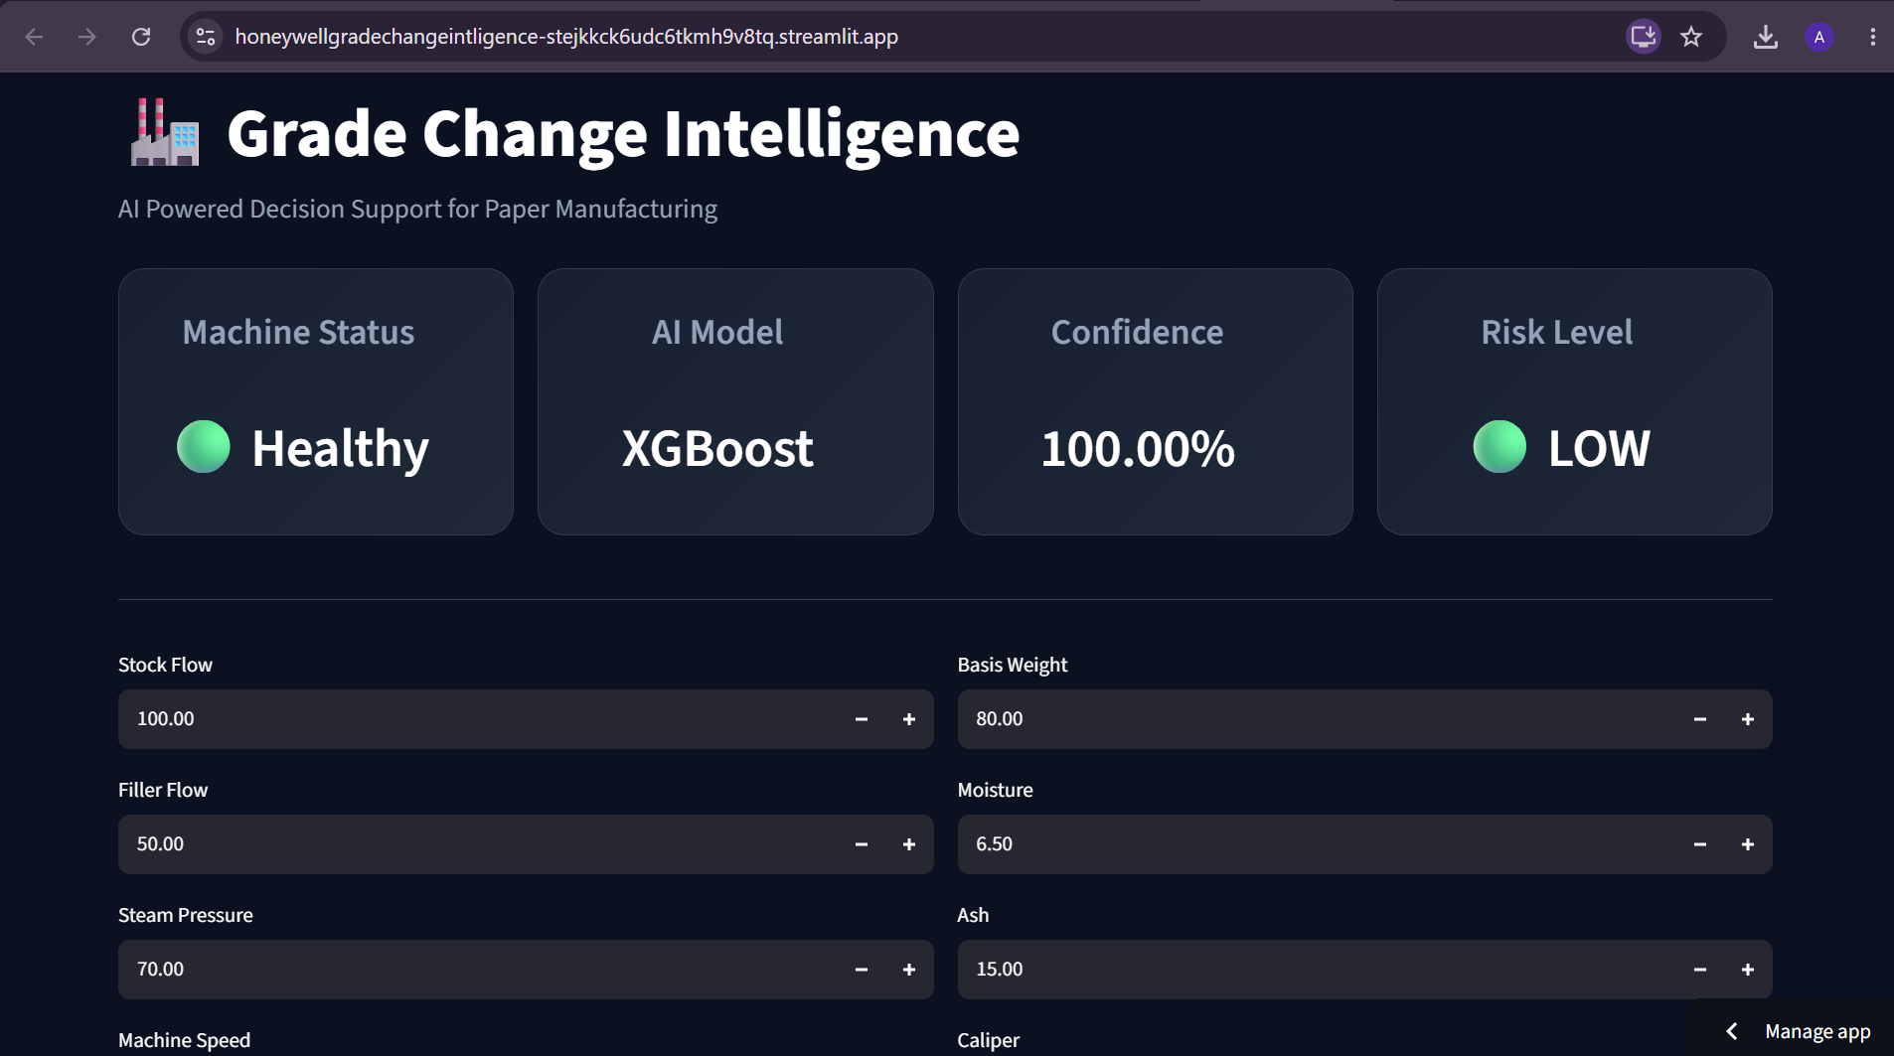
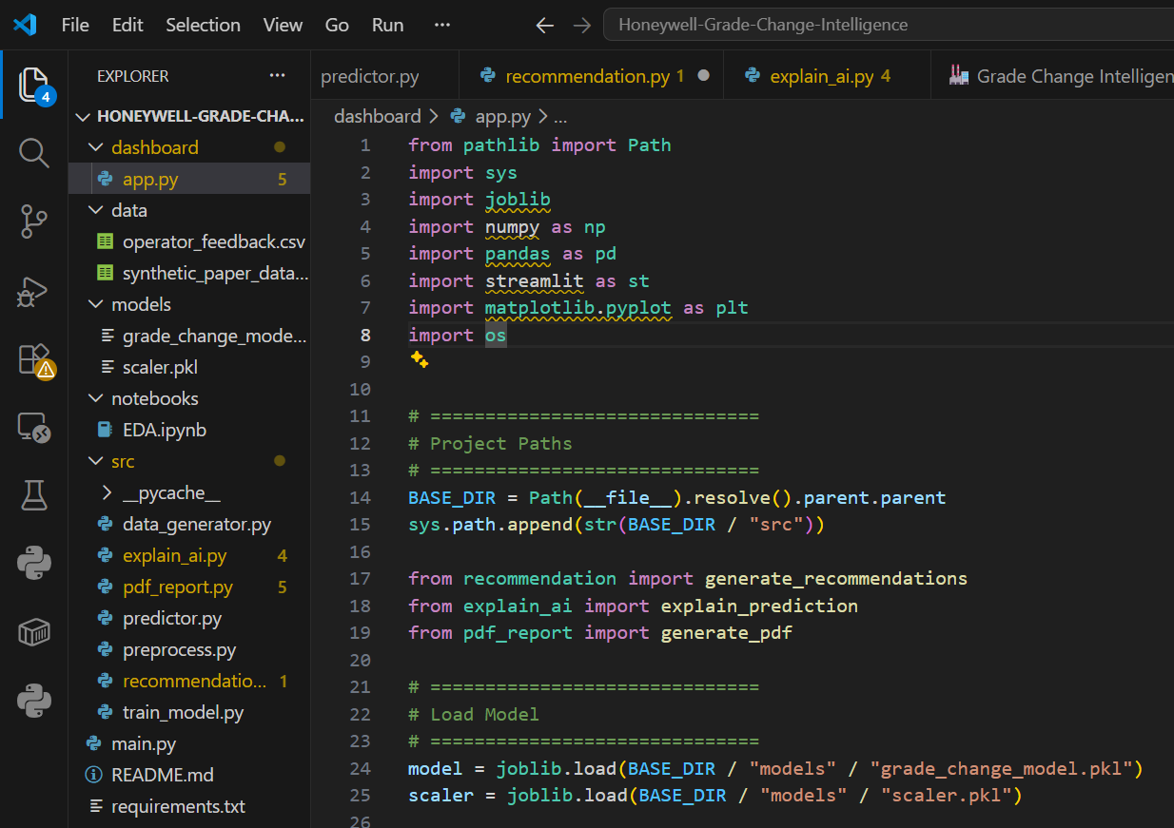
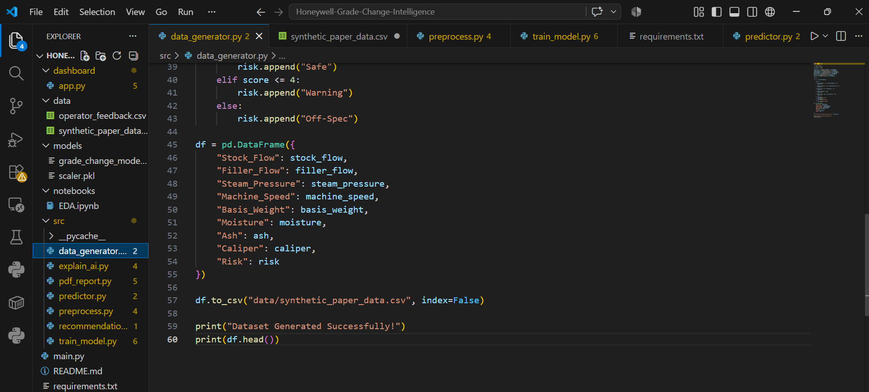
ARTIFACTS
Dashboard Snaps:
Snippet of the Machine Learning pipeline:

Slide 6
RESEARCH AND REFERENCES
Details / Links of the reference and research work:
XGBoost – Gradient boosting machine learning framework used for accurate classification and predictive analytics.
SHAP (Explainable AI) – Explainability technique that identifies the contribution of each feature to the model's prediction.
Scikit-learn – Python machine learning library used for data preprocessing, model utilities, and evaluation.
Streamlit – Open-source Python framework for building interactive data science and AI web applications.
Pandas – Data analysis library used for data cleaning, manipulation, and structured data processing.
ReportLab– Python library used to generate professional PDF reports programmatically.
Research Paper
Lundberg, Scott M., and Su-In Lee. "A unified approach to interpreting model predictions." Advances in neural information processing systems 30 (2017).
Chen, Tianqi, and Carlos Guestrin. "Xgboost: A scalable tree boosting system." In Proceedings of the 22nd acm sigkdd international conference on knowledge discovery and data mining, pp. 785-794. 2016.

